Slide 1


One click rent
Указать назване проектаНаз

Slide 2
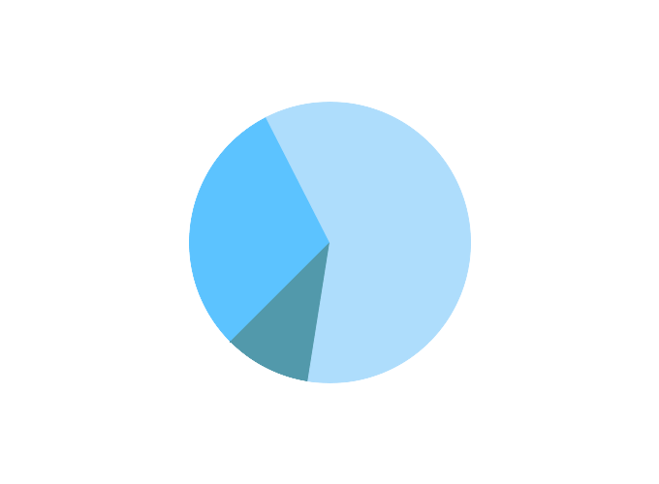
There are 21 000 organizations and companies engaged in rent in Belarus.
˟
2 million BYR
(200 BYN)
30%
↓
10%
16,8 billion BYR
(1,68 million BYN)

Slide 3
Problems
Time for issue an order.
Manual calculations.
Accounting and control of goods and orders.
Customer accounting.

Slide 4
Solutions
Reduction of time of ordering.
Automation of calculations.
Conducting of a flexible and transparent accounting system.
Customer accounting.

Slide 5
Market

Slide 6
Market
Regular demand for goods to rent.
A wide range of goods to rent.
Small and medium-sized businesses.

Slide 7
Competitors
Advantages over competitors:
adaptability to any type of goods to rent;
relatively low price;
functional configuration flexibility;
multi-purpose solutions for small and medium-sized businesses.

Slide 8
Main competitors
“SkiBars2.Rent” (original − “СкиБарс2.Прокат”).
“Rent expert” (original − “Прокат-Эксперт”).
“T-expert” (original − “Т-Эксперт”).
“Rent accounting software” (original − “Программа учета аренды и проката”).

Slide 9
Finance
There was 14% of companies growth per year from 2009 to 2016.
Expected revenues in the first year should be 1,6 billion BYR (160 000 BYN).
There is competitive price for license equal to 2 million BYR (200 BYN).

Slide 10
Development prospects
Multilanguage.
Web-application.
Application for rent customers.

Slide 11
Team
Designer.
Manager.
Developer.
Business analyst.
Software architect.

Slide 12
One click rent
Tel.: +375 29 679 79 36 +375 25 903 83 63 E-mail:
bdm@tut.by
Указать назване проектаНаз

